Slide 1
Data Scientists salary prediction in USA
George Edgar

Slide 2
Goal
Gain clarity on pursuing Data Science program through Glassdoor data analysis.
Predict salary change over long period.
Uncover typical expectations of data science employees by companies.

Slide 3
task
Data Collection
Data Cleaning
Exploratory Data Analysis
Model Building
Deploy Model

Slide 4

Data collection & cleaning
Kaggle
Salary parsing
Identify state
Job description parsing
Notes:
New column removing text in salary, split salary into min and max, get average salary, change hourly to annual salary. Check job desc. for skills

Slide 5
Exploratory Data Analysis

Slide 6
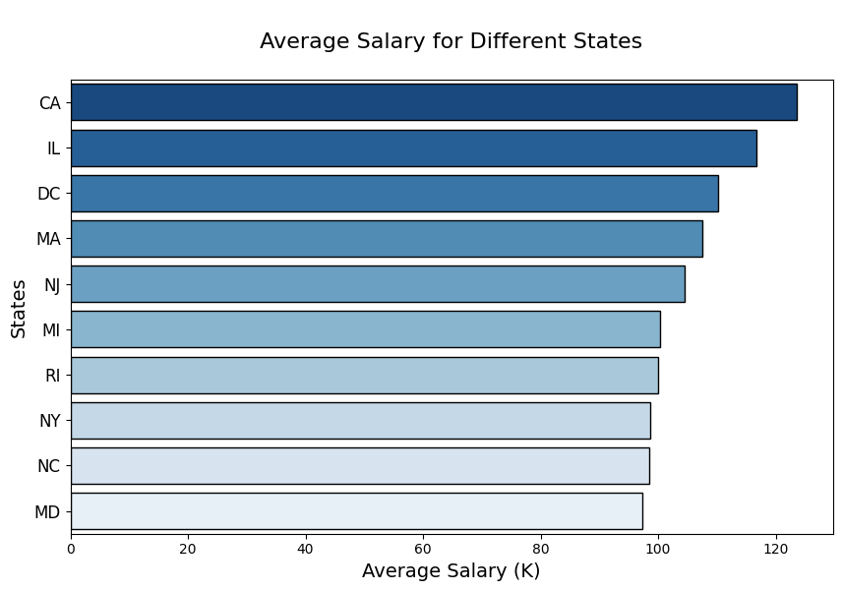
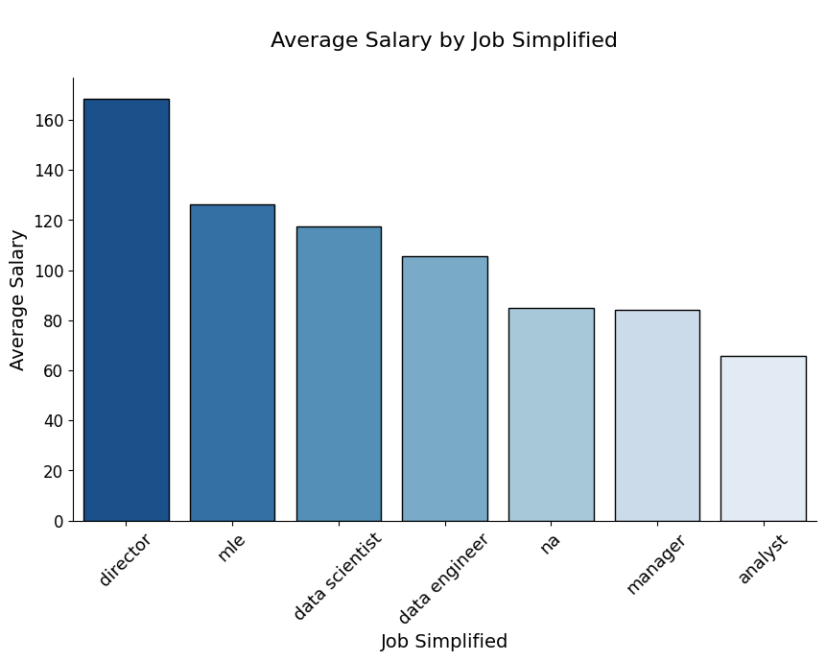
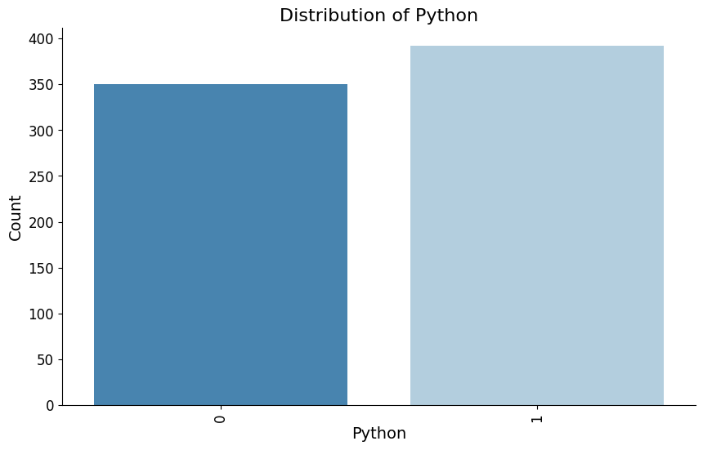
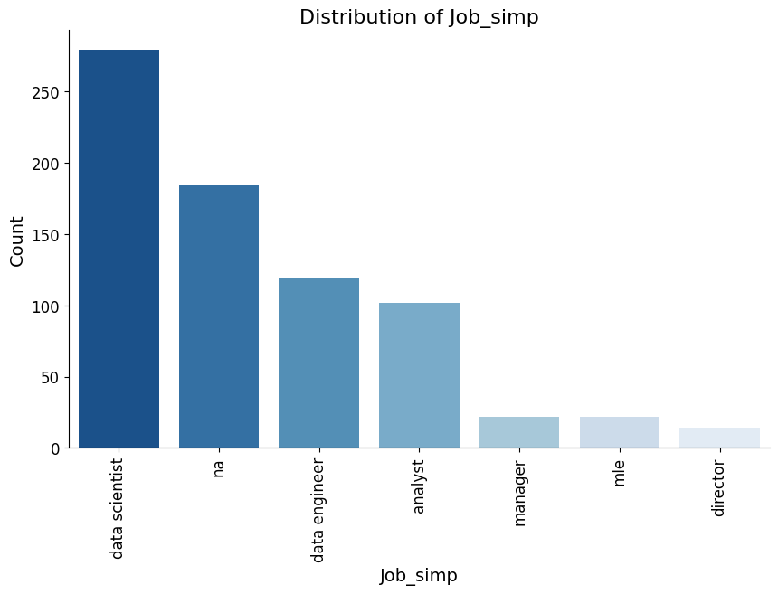

Slide 7
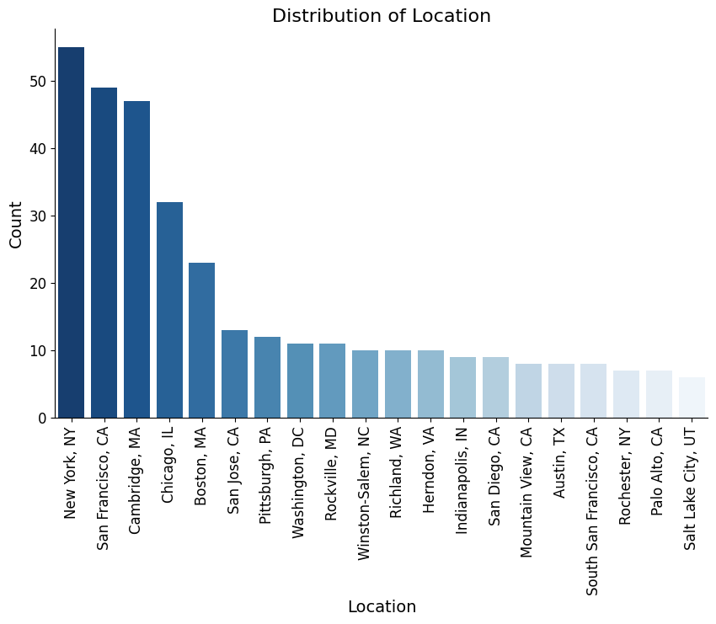
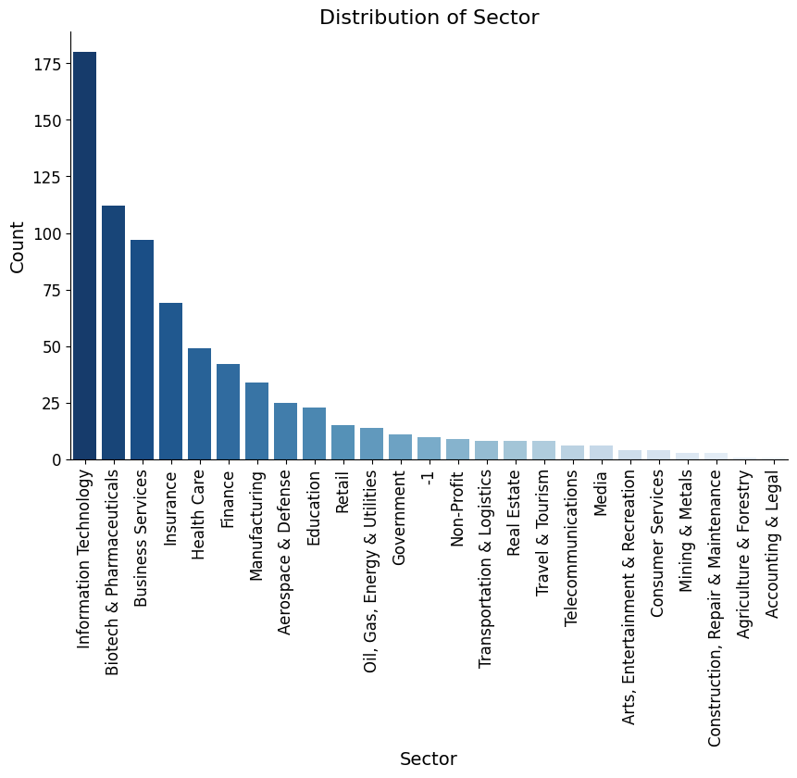
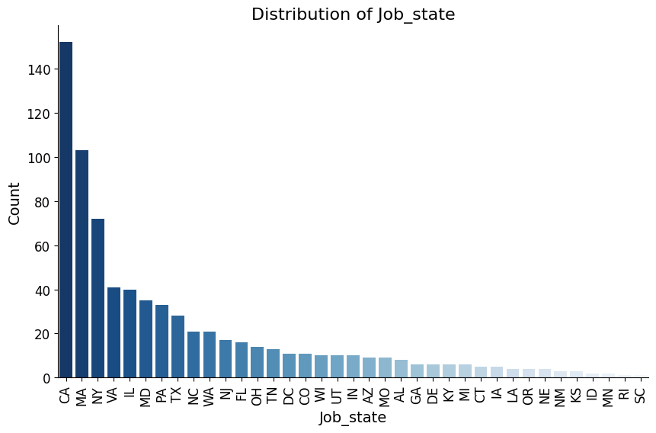
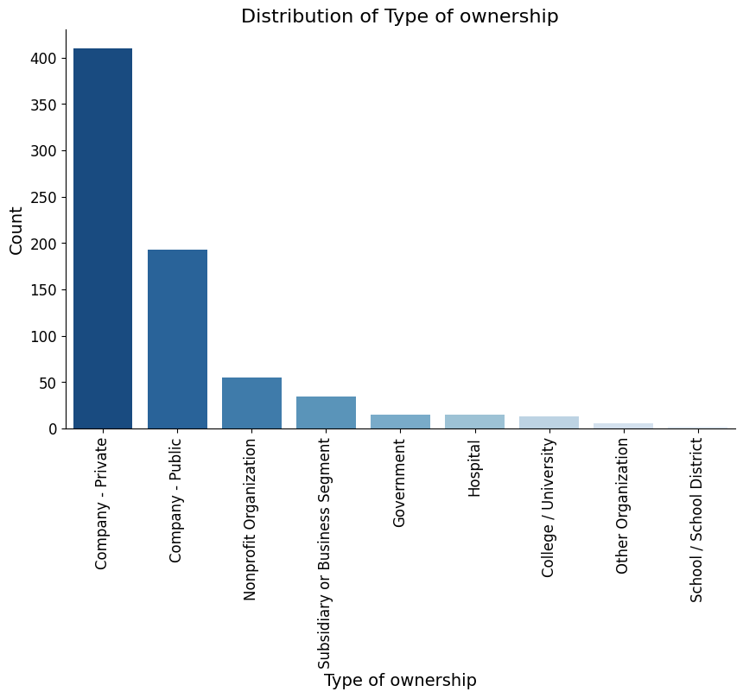

Slide 8
Model building
Chose columns
Dummy data
Train Test split –20% test
Multiple linear regression, Lasso regression, Random forest
Tune model using GridSearchCV
Test model

Slide 9
5-year data science salary prediction

Slide 10
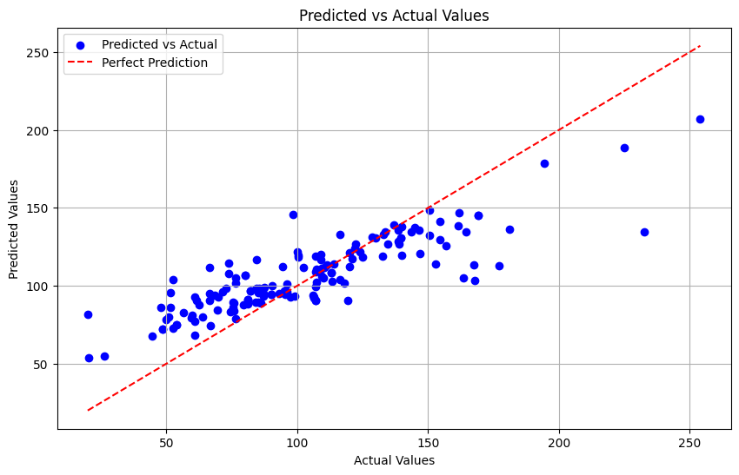

Slide 11
conclusion
Good accuracy of prediction
No Glassdoor API
Compare difference in salary over time
Predict change in sector listings

Slide 12


